Slide 1
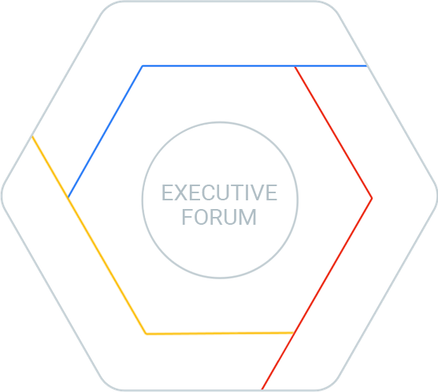
Migrating Legacy Applications to the Cloud
How SenTai supported Canaccord Genuity’s Move to Google Cloud Platform
David Senouf, PhD \\ CEO SenTai

Slide 2
SenTai
Who we are and what we do
‹#›

Slide 3
SenTai \\
SenTai: Consulting group specialized in FinTech, based in Paris, founded in 2013
Core Team: Group of (Data) Scientists, Engineers, and DevOps (developers & operations). Team can easily grow thanks to extensive network
Joint Work: Working together for 10 years in various Silicon Valley startups, Paris startups, as well as Paris based consulting projects
FinTech Experience: Each team member has extensive 10Y+ experience in the Financial Services industry - Platforms (Quest), Banking Systems (Banque de France), Infra & Big Data (AXA, SG, BNP)
Backgrounds: Academic Research (Mathematics & Physics), Computer Engineering (Infra / Big Data), Finance (Trading, Quant, Modelling & Data Science), Data Science (Algo Trading Algo, Aeronautics, GeoLoc)
‹#›
‹#›

Slide 4
Today’s Agenda
01 Why move to the cloud?
02 The Quest Equity Valuation Platform • What is Quest®? • Quest limitations prior to migration? • Reasons for limitations?
03 Migration • Challenges • Chronology • Infrastructure comparison
04 Benefits • Gains (Scalability, Performance, Agility) • Costs • Risk Mitigation (Security) • Feedback

Slide 5
01 Why move to the cloud?
‹#›

Slide 6
Why move key projects to the cloud?
Today \\ Legacy financial platform issues
Tomorrow \\ Cloud computing platform advantages
High Costs - Inefficiency - Difficulty to maintain - Lack of scalability
Slow development cycles
Complexity: Heterogeneous parts pieced together during lifespan of legacy applications
Managed Solutions (IaaS, PaaS): Scalability, Flexibility, Security, Economy and Performance
Fast Implementation - Little maintenance
Complete reset - Software architecture re-think thanks to Cloud tools (GCP)
‹#›
‹#›

Slide 7
02 The Quest Equity
Valuation Platform
What is Quest®?
Quest® limitations prior to migration?
Reasons for limitations?
‹#›

Slide 8
What is Quest?
An automated equity valuation computational platform
Quest is owned by Canaccord Genuity, a global investment bank
Quest is one of two (with CS’s Holt) major fully automated equity valuation tool available on the web: major differentiator for a mid-tier investment bank
Proprietary analytical equity research system
Analyzes 8,800 listed companies (90% of world market cap.)
End users are inst. investors, equity research analysts, portfolio managers, hedge funds
Data intensive, automated, high end computational platform
Computes thousands of performance metrics per company, sector, region
Uses 30 years of annual financial reports (and daily stock prices)
Website with numerous tables, charts and data also accessible via APIs
‹#›

Slide 9
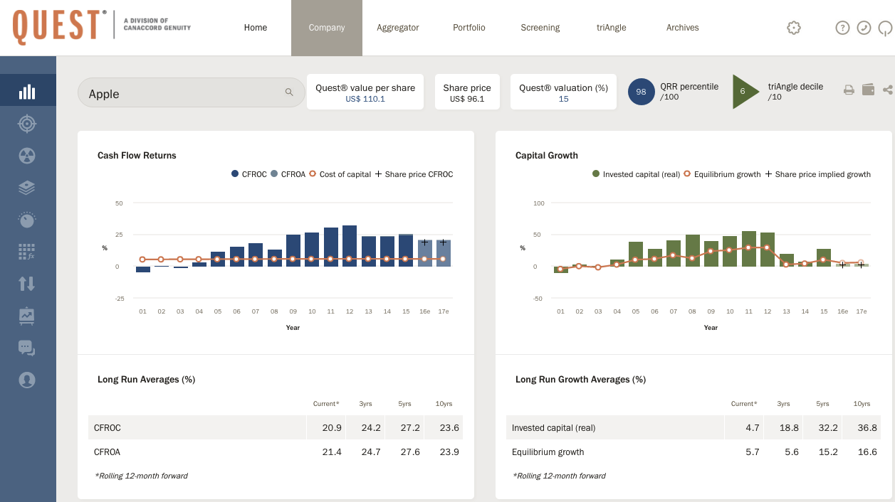
Notes:
Slick, easy to use, Web 2.0 responsive web interface

Slide 10
Quest limitations prior to migration
Reaching an End of Life: Lack of Scalability, Maintainability, and Evolution
Evolution of financial model limited
Increase in frequency of full computations from weekly to daily impossible
Increase in #companies, #industries, #regions impossible
Antiquated web interface
Infrastructure maintenance difficult and costly
New features impossible to implement
‹#›

Slide 11
Why such limitations?
The Obsolescence of Legacy Infrastructure
Hosted In-House: in 3 dedicated bare metal servers and multiple VMWare instances
Microsoft Technology: 15 year history, 4 Windows 2003 Servers, 11 SQL Server DBs 2008, ASP.net, Access Clients,...)
Overly complex valuation methodology and software architecture, with very slow in-DB computations (T-SQL)
Single weekly full computing cycle daily differentials, little contingency for errors or outages
‹#›

Slide 12
03 Migration
Challenges
Chronology
Infrastructure Comparison
‹#›

Slide 13
Migration Challenges (specific to Quest)
Remote Team: Communication between teams (SenTai/CG IT and Business, London and Paris)
Data Provider Changes: - From Thomson Reuters to S&P (Company Data) - From FTSE ICB to MSCI GICS (Industry Data) - Required the creation of a complex ETL (Extract, Transform, Load)
Data Management System: - A proprietary language was developed to assess data quality and flag outliers - An extensive admin web interface was designed to allow for possible overrides - Input: S&P data - Output: Override computations
‹#›

Slide 14
Migration Challenges (Continued)
Business Logic Documentation: - Limited - Needed to write documentation to adequately transform Business logic - 200+ computational phases and 7,000+ comp. rules
Valuation Model Documentation: Limited. Needed to reverse engineer and rewrite
Valuation Model and Computation Algorithm: entirely rewritten
Valuation Methodology Change - From SQL server transactional based computations (T-SQL) - to Google Sheet defined proprietary syntax handling time series - translated into Java (Antlr), run on GCE
Validation Phase: Lasted during entire development Phase (one year)
‹#›

Slide 15
Migration Chronology
Documentation, Model Rewrite, Software Architecture Reset, and Validation
Reverse Engineering GSuite (GA4W)
Prototype Development
GCP/GCE
Production
GCP/GCE
Transformation of legacy valuation model
From regular conference calls to Google Hangout
From Emails and Office docs to Google Apps and Google Docs shared documents (cf. BBVA)
New valuation methodology
Validation Phase 1
Once prototype was convincing enough, CG was ready for Google Cloud!
Full model rewrite and web development
FMR based on new syntax/new software architecture
New web 2.0 site
Extensive Validation Phase II (full scale)
5 months
7 months
1 year
‹#›
‹#›

Slide 16
Infrastructure Comparison
GCP vs MS bare metal
Before (Not Scalable)
Microsoft Technology
After (Scalable)
Google Technology & Open Source
3 Bare Metal Servers, fixed storage, RAM, CPU
3 VMWare Windows Servers per bare metal server
SSD & SCSI
No app (O.S.) virtualization
11 SQL Server DBs
SQL Server Access Clients
No APIs
3 Google Compute Engine instances, scalable specs
Single Virtual Machines: 32 vcpus/core, 208 GB RAM
SSD only persistent disks
Docker containers
NoDB, File System based (200+ computational stages)
Big Query. Tableau, Google Sheets
API driven
1 Windows / SQL Server for S&P Data Sync (reqd. By S&P)
‹#›

Slide 17
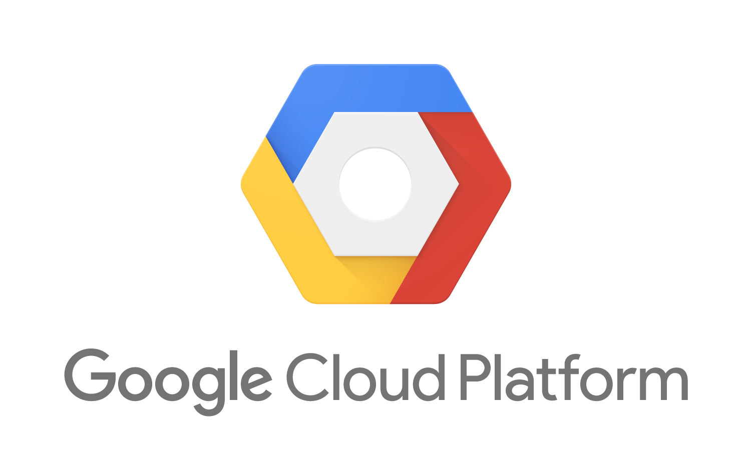
‹#›

Slide 18
04 Benefits
Scalability
Performance
Agility
Risk Mitigation
Costs and Rationale
‹#›

Slide 19
Benefits
Scalability
Before (10 hr)
After (30mn)
Weekly computations (frequency)
20 year history
2,200 companies
10 regions
100 industrial sectors in 2 level structure
Inability to scale up (F,Y,C,R,I.S.)
Static valuation model
Antiquated website
No new features
Daily computations (even intra-day)
30 year history (1.5x)
8,800 companies (4x)
25 regions (2.5x)
275 industrial sectors in 4 level structure (2.75x)
Scalable (F,Y,C,R,I.S.)
Dynamic valuation model
Web 2.0 user friendly
New features
‹#›

Slide 20
Benefits
Performance
Data (Quantity/Speed)
2.5x the amount of computed data (input)
1/20x of the time (30mn vs 10 hrs)
10x more aggregate computations (output)
120 billion data points per full run
7,000+ complex business rules using non trivial mathematical and numerical procedures
200+ computational stages
50 X
‹#›

Slide 21
Benefits
Agility - Flexibility of Valuation Model Changes
Before
After
Model Changes: minor modifications to the model required 1-2 months. Changes could only be performed by chosen external vendor
Deployment by developers only:
in-DB model and computations: entire compute engine carried out in DB calculations - SQL Stored Procedures (T-SQL) Very slow, difficult to fix model
Model Changes: Live editable model online by analysts simultaneously without programming knowledge Deployment of new model done by business analysts themselves!
Google Sheet: Rewrite model within GS, adding a proprietary syntax for handling of Time-Series
Model Translation: Into Java code from Google Sheet use ANTLR (language builder)
Java based computations on GCE
‹#›

Slide 22
Risk Mitigation

Slide 23
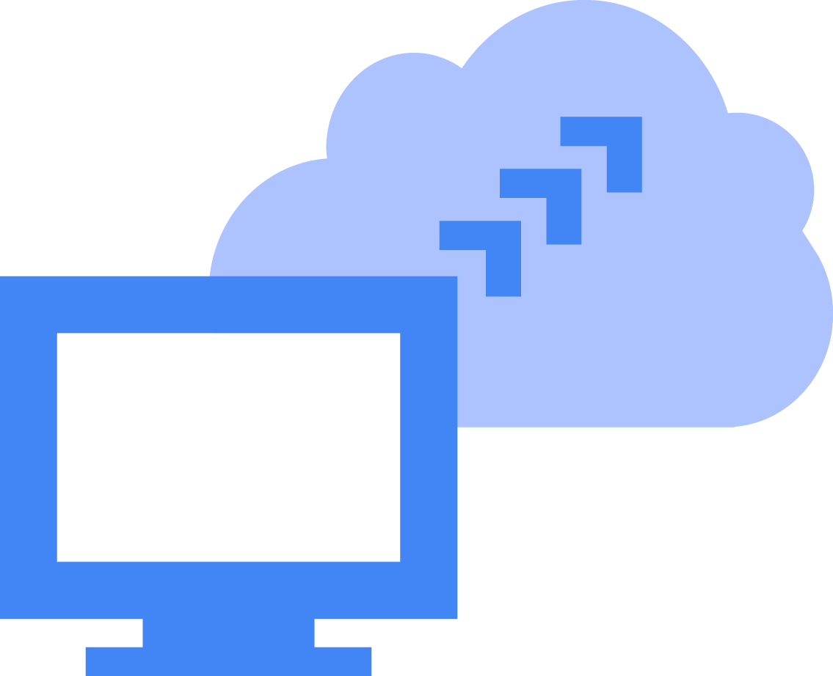
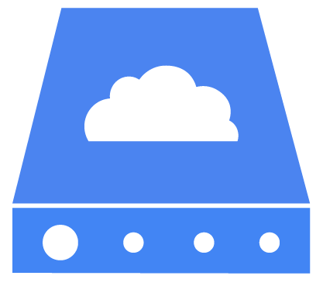
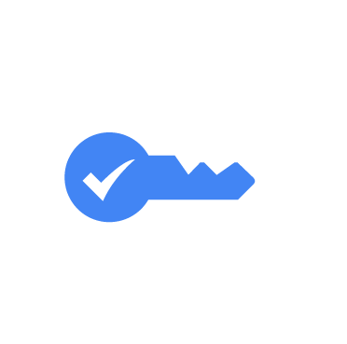
Security
Backups
Disaster Recovery
Several layers of security provided by Google infrastructure
Use of high speed Disk Cloning and Imaging. Several layers of backup processes available via managed GCP
Automatically redeploy from scratch entire production environment in 5mn, via single command line. 24h previously
Confidentiality
Intellectual Property
Cloud Restrictions
Customer information is a part of CG’s customer base, and minimal data is pushed to cloud platform for credentials, site preferences, site permissions
Permissioning (sharing) & restrictions to access to Valuation Model handled by Google Apps
Cloud restrictions imposed by S&P (financial data provider) required separate in-house SQL server
‹#›
‹#›
Notes:
Several layers of security provided by Google Infrastructure, and via secured APIs allowing to store, connect to GCP, and interconnect various components.
SSH deployment, HTTPS web, managed platform. (See also https://cloud.google.com/security/)

Slide 24
Rationale for Canaccord Genuity
Cost Reduction (4X) - Benefits
Total running costs vs. legacy costs
Benefits
Infrastructure costs @ GCP: Low monthly costs (less than $6500/month)
Maintenance: No maintenance of bare metal servers hosted in Canaccord datacenter
Autonomy: Canceling of costly technical outsourcing contract to maintain legacy in-house infrastructure
Resources: Reduction of data cleansing team by automation rules (ETL). Allows to reallocate resources
Performance: Stability, scalability, maintainability, evolution, agility, security
Integration: API technology between GSuite & GCP allowed to develop a fully integrated and efficient environment for both business and technology needs
Autonomy: Recover technical knowledge: appropriation of platform by in-house developers trained by us
Resources: Focus its resources on core business (i.e. model improvement)
‹#›

Slide 25
Successful Relaunch
Institutional Investor Feedback and Usage
Investment in Quest has created a state of the art platform in the cloud
Relaunch has been a huge success. Already we are witnessing increased broker votes in, and incremental revenues.
Portfolio Manager:
Senior Portfolio Manager:
Director of European Equities:
Research Analyst:
“It's an excellent tool and we love it. It fits all of our requirements and we appreciate all of the hard work done by the Quest® team.”
“In my personal opinion, the system really is outstandingly powerful. The system is very quick and looks very good. This is a website capable of winning an award for speed, user-friendliness and - if I may say – intelligence of icon design / subtle function prompt.”
“CITN (Quest Feature) is the best product on the street by a country mile and new Quest® is a fantastic tool.”
“Quest® product truly excellent. Product upgrade looks great.”
Fund Manager:
“Quest® refresh excellent.”
“New Quest® is now better than Holt.”
‹#›

Slide 26
“
With Google Cloud Platform, our product has deeper data, runs better analysis, is more customisable, handles more than 2.5x the load, and runs 20x faster than the old version.
”
Rob Garwood Head of IT Development, Canaccord Genuity
‹#›

Slide 27
Performance gains overview
100M+
9,000
Scale
120Bn
Google BigQuery grinds through over 100 million data rows in only a few minutes, at speeds at least 25x faster than the previous system.
Analyzes 30 years of data for almost 9,000 companies, 275 aggregate industrial sectors, 25 regions.
Migrated from a 15-year-old version that couldn’t scale.
Over 120 billion data points calculated overnight, and now several times per day (30 minutes).
‹#›

Slide 28
Read the full case study: https://sentai.eu/quest/ https://cloud.google.com/customers/canaccord-genuity/
Google Cloud Platform
Few Financial Services Companies have taken the leap into the cloud for key projects!
Canaccord Genuity is one of them through the Quest platform:
SenTai has adapted Quest to the cloud : leaving a Microsoft only, bare metal infrastructure, to Open Source and Google Cloud Platform, all at once!
SenTai is uniquely positioned to accompany you with your Cloud migration or development projects on GCP, regardless of the industry
‹#›

Slide 29
Thank You!
david@sentai.eu
‹#›

Slide 30
ANNEX
(Technical)
‹#›

Slide 31
Data Availability
Like most financial applications, Quest is driven by the ways in which the processed data is made accessible to end users, and available for analysis:
All users (Internal & External)
Website (primary use)
Download (xls, csv)
Big Query, TableauSoftware...
API (access limitations for external clients)
Internal users only (Canaccord Genuity)
Google Sheets and centralized Google scripts (using REST APIs and Google Managed Library)
Web Admin Interface
‹#›

Slide 32
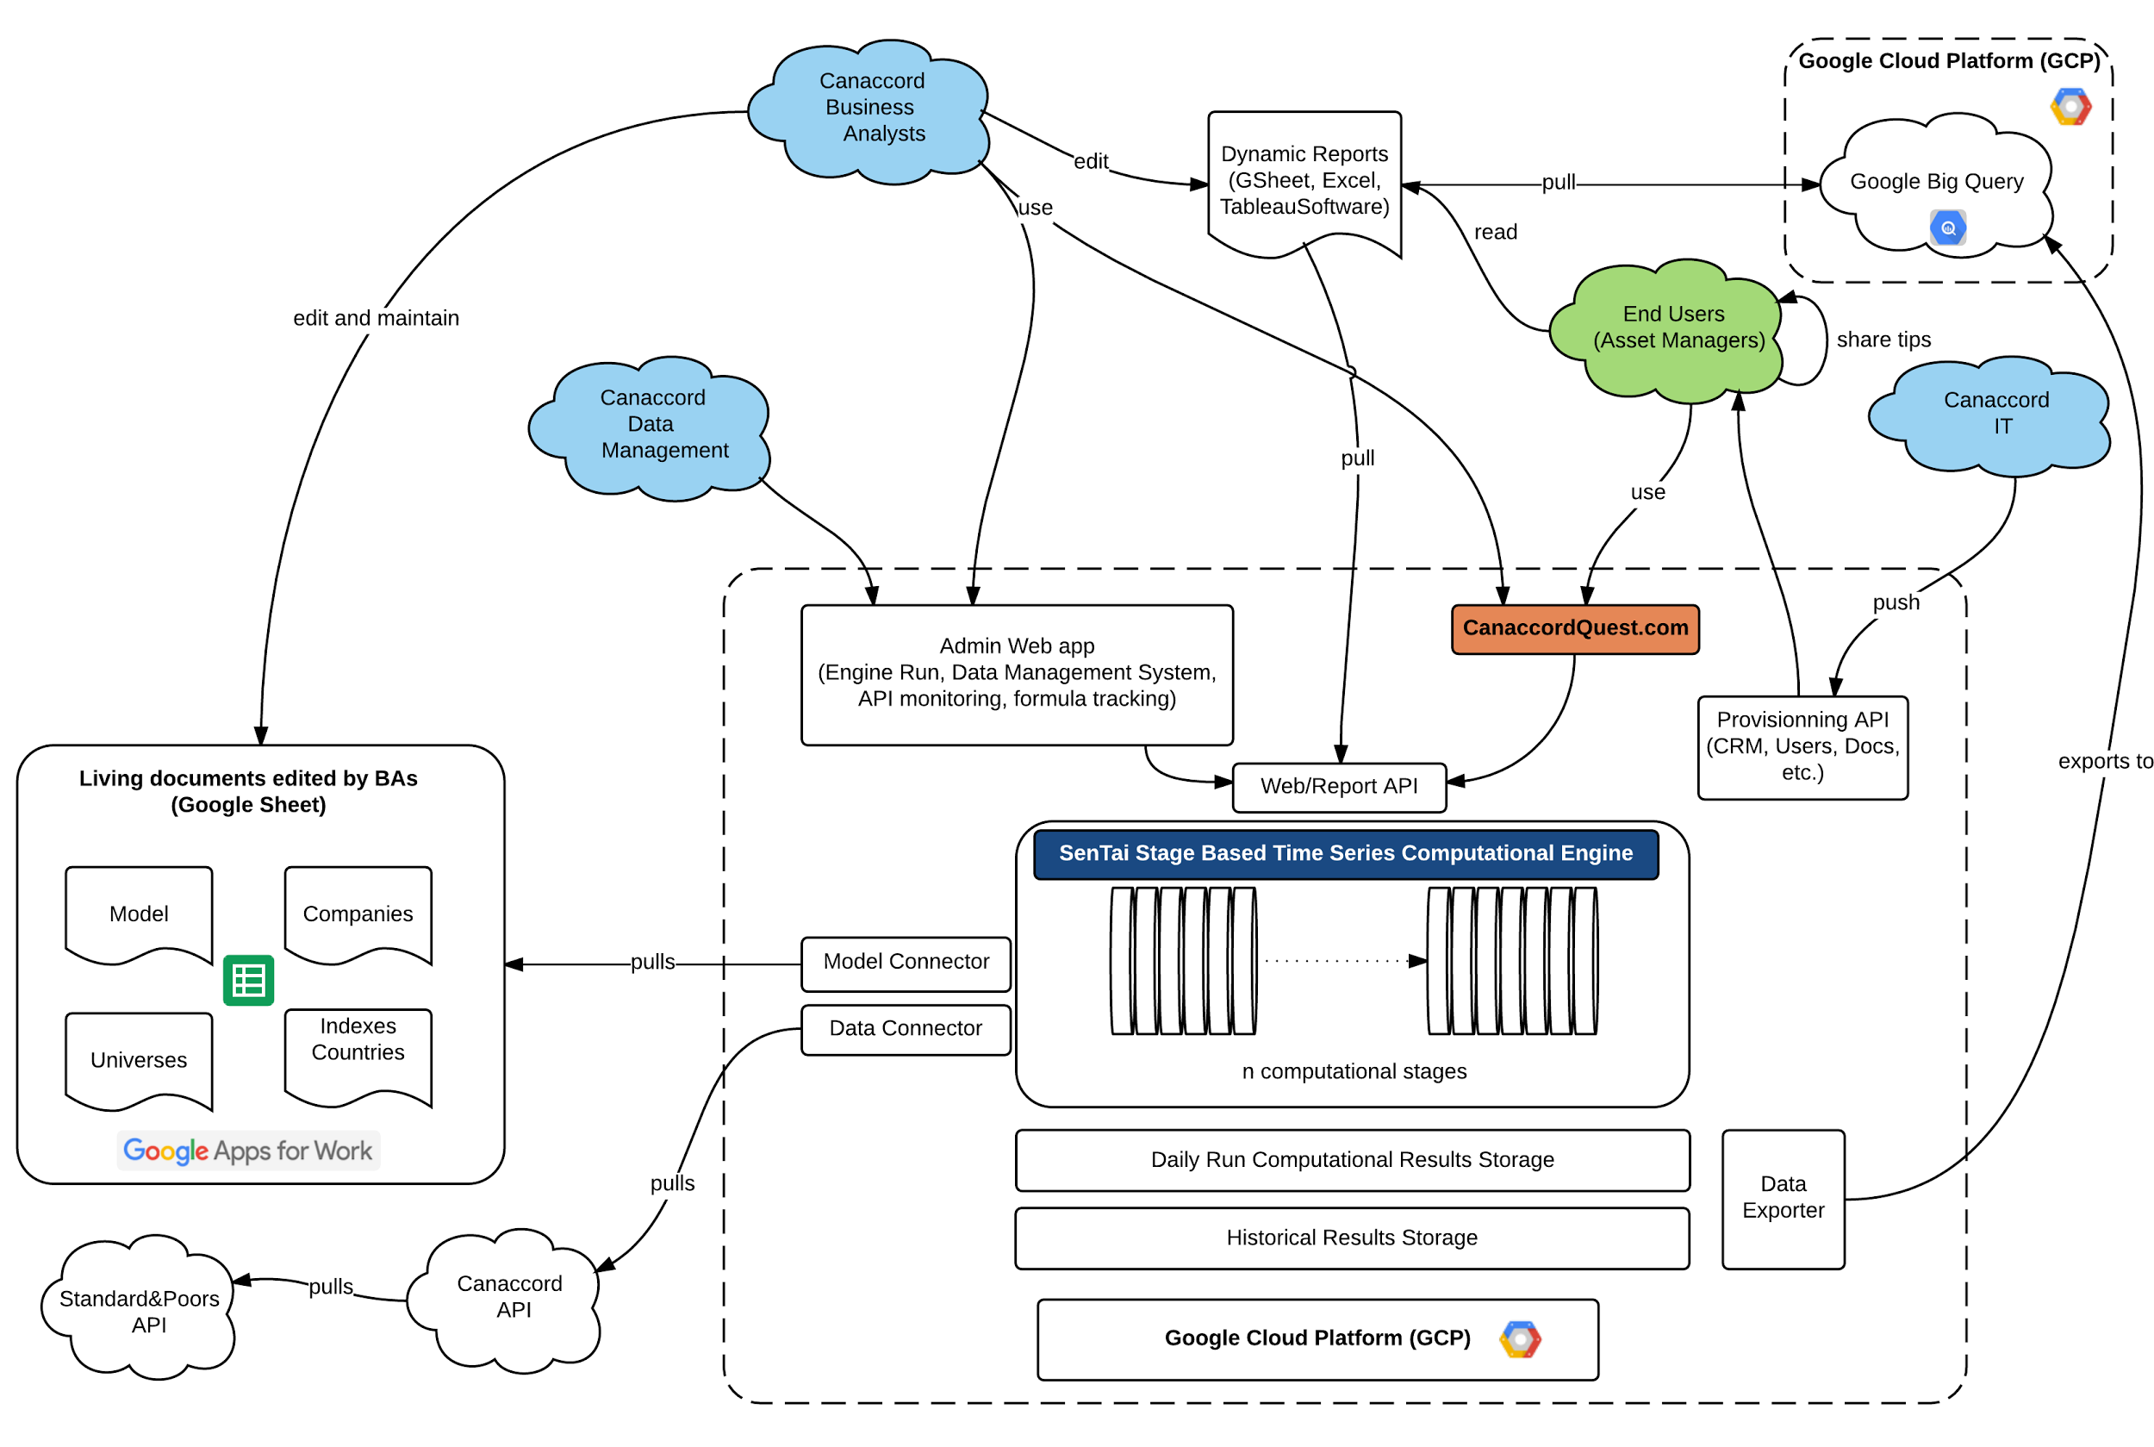
Architecture GCP & GSuite
Architecture: GCP & GSuite
‹#›

Slide 33
Technology Stack (software)
Docker Containers (OS virtualisation, portability and ease of deployment)
Debian 8 (Linux operating system)
Ansible, Jenkins, Hubot, Nginx (provisioning, automation, deployment, proxy)
Java 8 (programming language), Antlr (language builder)
NoDB, entirely File System based to optimize 200+ stage computational speed.
StackDriver (monitoring), Swagger (API documentation)
Web 2.0 (REST, Bootstrap, AngularJS, Coffeescript, Javascript)
Post computational analysis: Google Big Query, Google Sheets, Tableau, APIs
(GSuite/Non GCP): Google Sheets, Docs, Hangouts, Keep, Calendar, Drive
(SaaS): Atlassian Jira, BitBucket, Slack, Trello (bug tracking, Git DVCS, collaboration)
‹#›

